Slide 1
Climate Change Litigation & Insurance Implications
Richard K. Traub, Esq. and Adam Krauss, Esq.
Traub Lieberman Straus & Shrewsberry LLP
Presented to AIDA World Congress – Rio de Janeiro, Brazil October 12, 2018

Slide 2
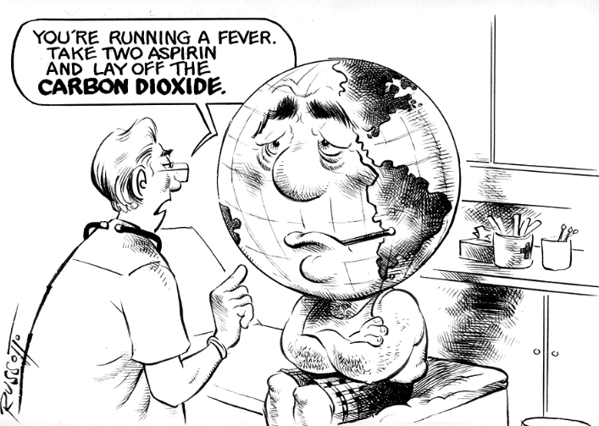
Climate Change Science The Basics

Slide 3
What Is The Difference Between Weather & Climate ?
The difference is a measure of time:
Weather = Conditions of the atmosphere over a short period of time.
Climate = how the atmosphere "behaves" over relatively long periods of time.
Notes:
Climate is the aggregated patterns of weather, meaning averages, extremes, timing, and spatial distribution of weather events.
Climate change means altered patterns of weather.
Small temperature changes = Big changes in weather patterns

Slide 4
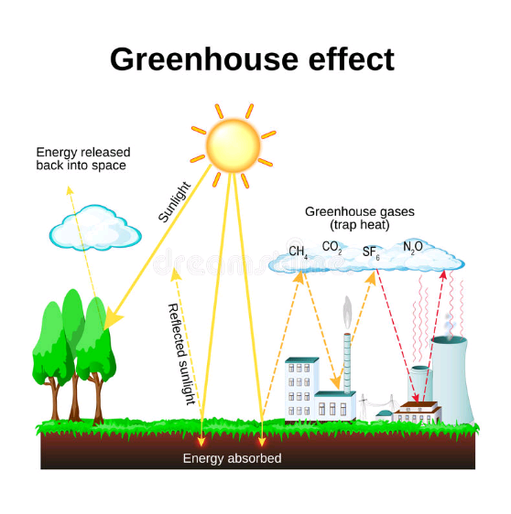
The Greenhouse Effect
The Greenhouse Effect describes how natural gases in the Earth’s atmosphere reduce the amount of heat escaping from the Earth into the atmosphere:

Slide 5
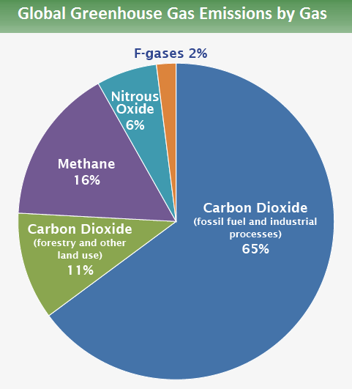
The Greenhouse Effect
IPCC (2014)

Slide 6
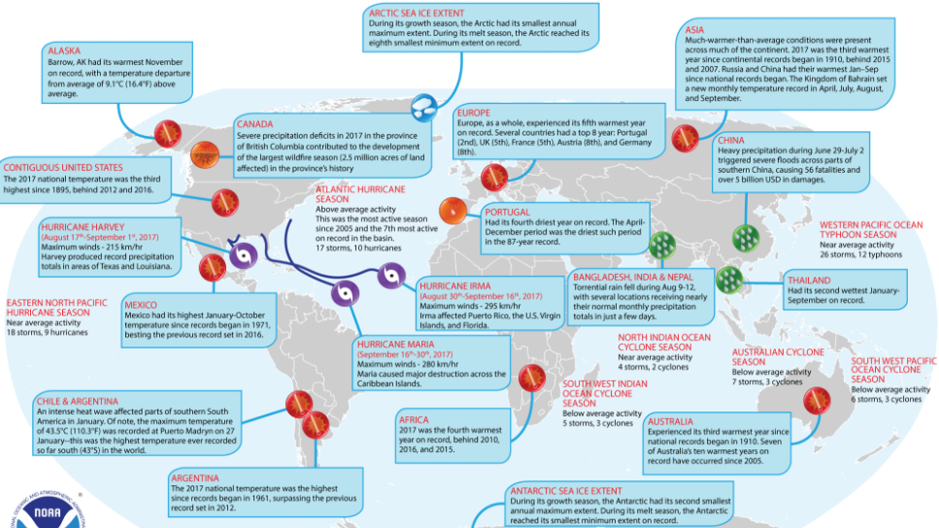

Slide 7
Brief History of Climate Change Events
1712 - British ironmonger Thomas Newcomen invents the first widely used steam engine, paving the way for the Industrial Revolution and industrial scale use of coal.
1800 - World population reaches one billion.
1824 - French physicist Joseph Fourier describes the Earth's natural "greenhouse effect".
1886 - Karl Benz unveils the Motorwagen, often regarded as the first true automobile.
1927 - Carbon emissions from fossil fuel burning and industry reach one billion tons per year.
1930 - Human population reaches two billion.

Slide 8
Brief History of Climate Change Events
1938 - Using records from 147 weather stations around the world, British engineer Guy Callendar shows that temperatures had risen over the previous century. He also shows that CO2 concentrations had increased over the same period, and suggests this caused the warming. The "Callendar effect" is widely dismissed by meteorologists.
1960 - Human population reaches three billion.
1975 - Human population reaches four billion.
1975 - US scientist Wallace Broecker puts the term "global warming" into the public domain in the title of a scientific paper.
1987 - Human population reaches five billion

Slide 9
Brief History of Climate Change Events
1987 - Montreal Protocol agreed, restricting chemicals that damage the ozone layer. Although not established with climate change in mind, it has had a greater impact on greenhouse gas emissions than the Kyoto Protocol.
1989 - UK Prime Minister Margaret Thatcher - possessor of a chemistry degree - warns in a speech to the UN that "We are seeing a vast increase in the amount of carbon dioxide reaching the atmosphere... The result is that change in future is likely to be more fundamental and more widespread than anything we have known hitherto." She calls for a global treaty on climate change.

Slide 10
Brief History of Climate Change Events
1989 - Carbon emissions from fossil fuel burning and industry reach six billion tons per year.
1992 - At the Earth Summit in Rio de Janeiro, governments agree the United Framework Convention on Climate Change. Its key objective is "stabilization of greenhouse gas concentrations in the atmosphere at a level that would prevent dangerous anthropogenic interference with the climate system". Developed countries agree to return their emissions to 1990 levels.
1997 - Kyoto Protocol agreed. 192 parties pledge to reduce emissions by an average of 5% by the period 2008-12, with wide variations on targets for individual countries. US Senate immediately declares it will not ratify the treaty.

Slide 11
Brief History of Climate Change Events
1998 - Publication of the controversial "hockey stick" graph indicating that modern-day temperature rise in the northern hemisphere is unusual compared with the last 1,000 years.
1999 - Human population reaches six billion.
2005 - The Kyoto Protocol becomes international law for those countries which have ratified.
2006 - Carbon emissions from fossil fuel burning and industry reach eight billion tons per year.
2008 - Half a century after beginning observations at Mauna Loa, the Keeling project shows that CO2 concentrations have risen from 315 parts per million (ppm) in 1958 to 380ppm in 2008.

Slide 12
Brief History of Climate Change Events
2009 - China overtakes the US as the world's biggest greenhouse gas emitter - although the US remains well ahead on a per-capita basis.
2010 – EPA issued the final “Timing Rule” which stated that the earliest that GHGs could be subject to regulation is 1/2/2011.
2011 - Human population reaches seven billion.
2011 - Data shows concentrations of greenhouse gases are rising faster than in previous years.

Slide 13
Brief History of Climate Change Events
2012 - Arctic sea ice reaches a minimum extent of 1.32 million sq. mi., a record for the lowest summer cover since satellite measurements began in 1979.
2015 – “Paris Agreement” signed by 195 countries. Only Nicaragua & Syria refuse. The parties agree, inter alia, to limit warming to “well below” 3.6 degrees F. (2 degrees Celsius), as measured from pre-industrial levels.
2017 – President Trump states that U.S. will pull out of the Paris Agreement, in keeping with his “America first” message. However, under terms of the Agreement, U.S. cannot withdraw until 11/4/2020, the day after the next presidential election.

Slide 14
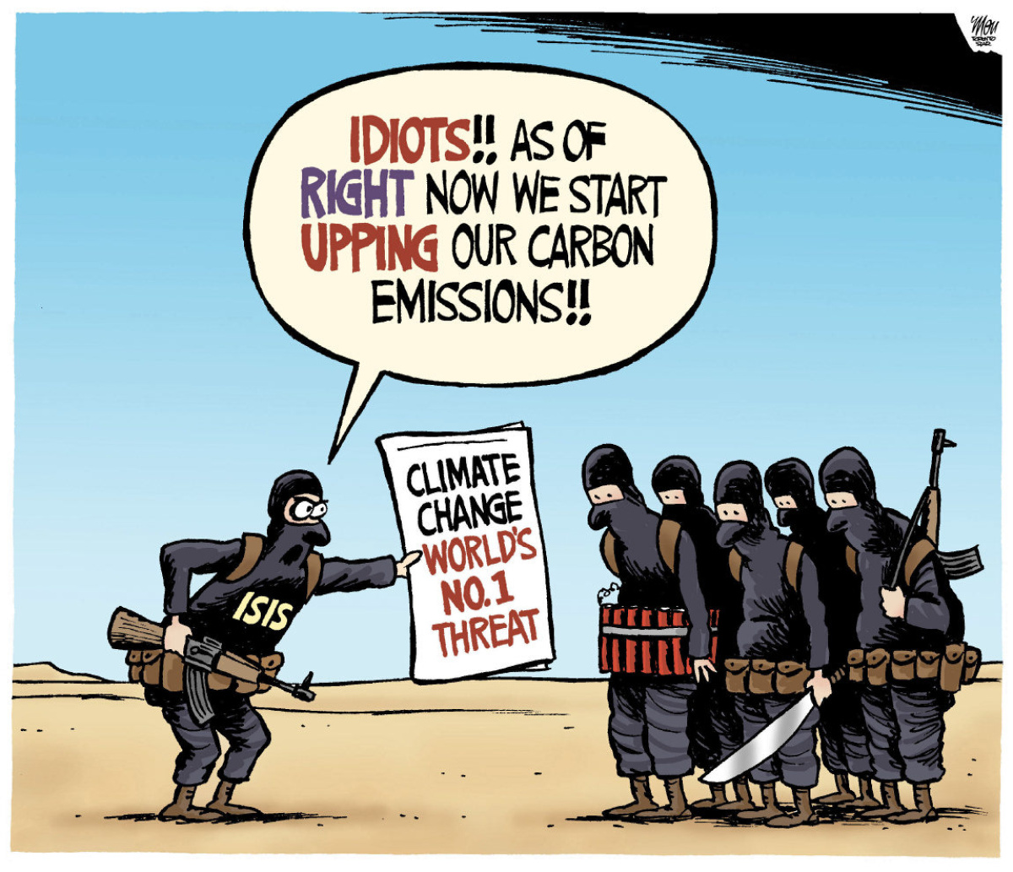
Climate Change Litigation (Past, Present & Future)

Slide 15
Threshold Issues
Climate Change Litigation raises two common recurring threshold issues:
“Justiciability”
“Standing”
Notes:
In the U.S., “justiciability” refers to the plaintiff’s ability to claim a remedy when a violation of a right either has occurred or is likely to occur.
A suit is “justiciable” if the court is empowered to decide the matter and considers it appropriate to do so. The analysis involves both legal and prudential questions. The controversy must be “definite and concrete, touching the legal relations of the parties having adverse legal interests.”
To demonstrate “standing,” a litigant must show that it has suffered a concrete and particularized injury that is either actual or imminent, that the injury is fairly traceable to the defendant, and that a favorable decision will address the injury.

Slide 16
Climate Change Litigation -- The Past
Massachusetts v. EPA, 549 U.S. 497 (2007)
Group of States, local governments and environmental organizations sought review of an EPA order denying a petition for rulemaking to regulate GHG emissions from vehicles under the Clean Air Act (“CAA”).
The U.S. Supreme Court ruled 5-4 that GHGs are air pollutants covered by the CAA. (“Greenhouse gases fit well within the CAA’s capacious definition of air pollutant.”)
EPA may regulate GHGs if they are determined to be a danger to human health.
Massachusetts had standing to sue based on its “special position and interest” and its "special solicitude.”

Slide 17
The Past
Massachusetts v. EPA, 549 U.S. 497 (2007)
Dissent (Roberts, Scalia, Thomas & Alito):
By Roberts:
Global warming may be a ‘crisis,’ even ‘the most pressing environmental problem of our time.” … It is not a problem, however, that has escaped the attention of policy makers in the Executive and Legislative Branches of our Government, who continue to consider regulatory, legislative, and treaty- based means of addressing global climate change. Apparently dissatisfied with the pace of progress … petitioners have come to the courts claiming broad-ranging injury, and attempting to tie that injury to the Government’s alleged failure to comply with a rather narrow statutory provision. I would reject these challenges as nonjusticiable.

Slide 18
The Past
Comer v. Murphy Oil USA, 585 F.3d 855 (5th Cir. 2009)
Fifth Circuit held:
- All claims were barred by res judicata and collateral estoppel (based on complicated procedural history).
- Alternatively, Court held that plaintiffs do not have standing because their alleged injuries are not “fairly traceable to the defendants’ conduct.”
Moreover, Court found that the suit presented a non-justiciable political question, and that all plaintiffs’ claims were preempted by the CAA.
The Court further found that “… plaintiffs cannot possibly demonstrate that their injuries were proximately caused by the defendants’ conduct.”
Notes:
Residents and owners of lands and property along the Mississippi Gulf coast sued various company’s alleging defendants’ operations caused the emission of GHGs that contributed to global warming that in turn, caused a rise in sea levels and added to the strength of Hurricane Katrina, which combined to destroy plaintiffs’ private property, as well as public property useful to them.
Plaintiffs asserted Mississippi common-law actions of public and private nuisance, trespass, negligence, unjust enrichment, fraudulent misrepresentation and civil conspiracy.
Compensatory and punitive damages were sought. No injunctive relief sought.
Complicated procedural history - - not pertinent.

Slide 19
The Past
Am. Elec. Power, et. al. v. Connecticut, et al, 564 U.S. 410 (2011)
Supreme Court Held:
“Based on EPA's designated authority, it is up to the EPA to decide whether and how to regulate GHGs from power plants.” However, the court does leave a course of legal action open in the event the EPA does not enforce emissions limits against regulated sources by allowing "any person" to bring civil enforcement action in federal court. Also, if the EPA does not set emissions limits for certain pollutants or pollution sources, states and private parties can petition for a rulemaking in federal court.
Significance:
Confirms the EPA's primacy as the regulator of GHGs under the CAA initially established in Massachusetts v. EPA and arguably limits the possibility of claiming federal common law public nuisance for climate change litigation.
Notes:
Eight states, the City of New York, and three land trusts, separately sued the same electric power corporations that owned and operated fossil-fuel-fired power plants in twenty states. The States sought to cap-and-abate the companies GHG emissions due to alleged ongoing contributions to global warming. Alleged that the companies are the five largest emitters of GHGs in the United States.
Causes of Action:
Companies’ emissions substantially and unreasonably interfered with public rights in violation of the federal common law of interstate nuisance, or in the alternative, of state tort law.

Slide 20
The Past
Native Village of Kivalina v. ExxonMobil Corp., 696 F.3d 849 (9th Cir. 2012)
Alaskan tribal village alleged that their village is being threatened by the effects of climate change - - specifically, by the reduction in protective sea ice and an increase in storms and flooding and asserted that the 24 oil, energy, and utility companies named as defendants should be held liable for the costs of relocating the village, because they had allegedly contributed to the risks of climate change through their GHGs emissions.
Brought as a “nuisance” claim under federal common law.
Only monetary relief sought - $400 million to relocate village.
Notes:
Ninth Circuit Held:
Finding these decisions controlling, the panel held that the federal common law claims in Kivalina were displaced by the CWA.

Slide 21
The Past
Other Significant Cases:
Korsinsky v. EPA, 2006 U.S. App. LEXIS 21024 (2nd Cir. 2006)
Finding pro se plaintiff’s claim that global warming and carbon dioxide emissions may cause him future injury too speculative to confer standing.
People of the State of Calif. v. General Motors, et al. – Northern Dist. Of Calif., No. 3:06-cv-05755 (2007)
Court granted defendants’ motion to dismiss plaintiff’s Federal and State public nuisance claims that the defendant automakers created and contributed to a public nuisance – global warming.
Plaintiff sought monetary damages and a D.J. for future monetary expenses.
The Federal District Court, citing Mass. v. EPA stated: “Plaintiff has failed to provide the Court with sufficient explanation or legal support as to how this Court could impose damages against the defendant automakers without unreasonably encroaching into the global warming issues currently under consideration by the political branches.”
Notes:
The Court further remarked: “Unlike the procedural posture of Mass. v. EPA, the current case is not before the Court by way of an administrative challenge to an EPA’s decision, but rather as an interstate global warming damages tort claim.”

Slide 22
The Present: The Big Ten US Climate Change Lawsuits
County of San Mateo v. Chevron, et al., No. 17-CIV-03222, Calif. Sup. Ct. (2017)
County of Marin v. Chevron, et al., No. 17-CIV-1702586, Calif. Sup. Ct. (2017)
City of Santa Cruz v. Chevron, et al., No. 17-CIV-03242, Calif. Sup. Ct. (2017)
City of Richmond v. Chevron, et al., C18-00055, Calif. Sup. Ct. (2018)
City and County of San Francisco & City of Oakland v. BP, et al., No. 3-cv-06012, N.D. Calif. (2018) (As removed)
City of New York v. BP, et al., No. 18-cv-00182, S.D.N.Y. (2018)
City of Boulder, et al. v. Suncor Energy (U.S.A.), et al., 1:18-cv-01672, U.S.D.C., Dist. Of Colorado (2018) (As removed)
King County v. BP p.l.c, et al., 2:18-cv-00758, W.D. Wash. (2018) (As removed)
Rhode Island v. Chevron, et al., 1:18-cv-00395, D.R.I (2018) (As removed)
Mayor & City Council of Baltimore v. BP p.l.c., et al., 1:18-cv-02357, D.Md. (2018) (As removed)
Notes:
I will review some, not all.

Slide 23
The Present
“The Big Ten” U.S. Climate Change Lawsuits
Ten suits, with four different primary approaches:
San Mateo, Marin, Santa Cruz, Richmond, Baltimore, & Rhode Island Suits
30+ defendants
Claims under State law for public & private nuisance, strict liability for failure to warn, strict liability for design defect, negligence, negligent failure to warn, trespass, Maryland Consumer Protection Act (Baltimore) and Rhode Island Envt’l Rights Act.
Seek compensatory damages, abatement of the alleged nuisance, punitive damages, and disgorgement of profits.

Slide 24
The Present
2) San Francisco, Oakland and King County Suits
- 5 defendants (BP, Chevron, ConocoPhillips, ExxonMobil and Royal Dutch Shell)
- Claims for public nuisance and trespass (King County).
- Seek an order requiring the companies to abate the nuisance by
funding a “climate adaptation program” to build sea walls and other infrastructure necessary to protect public and private property from sea level rise and other climate impacts. Compensatory damages (King County).

Slide 25
The Present
3) New York City Suit
- Led by City Corp. Counsel
- 5 defendants (BP, Chevron, ConocoPhillips, ExxonMobil and Royal Dutch Shell)
- Claims for Federal & State public and private nuisance and trespass
- Seeks compensatory damages and an order requiring the companies to abate the nuisance if compensatory not paid.
Notes:
(with Hagens Berman and Seeger Weiss firms as co-counsel)

Slide 26
The Present
4) Boulder, CO Suit
First climate change suit by an inland-mountain State.
2 defendants (ExxonMobil and Suncor Energy)
Claims for public and private nuisance, trespass, unjust enrichment, and deceptive trade practices under Colorado Consumer Protection Act.
Alleges that while average annual temps over the mainland U.S. have increased by 1.8 degrees F since 1895, Colorado has seen average rise of 2.5 degrees F.
Alleges “a significant portion” of CO2 remains in the atmosphere, with a “warming influence that lasts for hundreds (if not thousands) of years.”
Further asserts that Colorado’s economy “depends on snow, water and cool weather” and the “$5 billion ski industry is in jeopardy as a result of ‘low-snow’ winters and shorter seasons.”

Slide 27
The Present
Other U.S. Climate Change Lawsuits
The Allegations and Relief Sought
All suits allege damage to the municipality’s own property, as well as to the public at large.
All suits allege nuisance due to, inter alia, sea level rise, increased flooding and intensified storms.
The Trespass claims all allege sea level rise and increased flooding onto owned property.
All suits allege varying degrees of defendants’ knowledge (going back decades) of global warming, sea level rise and other climate change.
Notes:
BUT San Mateo, Marin, Santa Cruz, Richmond, Baltimore & Rhode Island Suits contain more expansive knowledge based allegations, given claims for strict liability (failure to warn & design defect), and negligent failure to warn.
All suits contain much of the same climate change “data” allegations, with each suit tailoring impact of sea level rise, etc. to their particular geographic location and other unique individual aspects.
Boulder, Co suit is the only lawsuit by an inland state entity.
Rhode Island suit is the only lawsuit by a state.

Slide 28
The Present
ALL big ten suits were removed by defendant fossil fuel companies to Federal Court (except NY suit which was originally brought in Federal).
San Mateo, Marin, Santa Cruz & Richmond State Court Suits
Federal court granted Plaintiffs’ motions to remand back to state court.
Defendants’ appeals challenging remand are pending before Ninth Circuit.
No substantive rulings yet.
Likely motions to dismiss for failure to state a claim and for lack of personal jurisdiction to be filed after removal/remand issue fully resolved.

Slide 29
The Present
San Francisco/Oakland Federal Court Suit
- Federal court denied Plaintiffs’ motions to remand back to state court.
A Court Ordered three-hour Climate Change Tutorial to educate Judge took place late-March 2018.
On 6/25/18, the Court granted defendant fossil fuel companies’ Motions to Dismiss the Cities’ Amended Complaint for failure to state a claim. Court ruled that the CAA displaced Plaintiffs’ nuisance claims and found that the displacement rule applies to the Cities’ claims even though the claims were not based on the defendants’ own GHG emissions but on their sale of fossil fuels to other parties that will eventually burn the fuels.
On 7/27/18, the Court granted motions of four fossil fuel companies’ to Dismiss for lack of personal jurisdiction, finding that it was “manifest that global warming would have continued in the absence of all California-related activities of defendants. Court held that Plaintiff Cities did not satisfy the “but-for” causation standard because they failed to adequately link the four companies alleged California activities to the alleged climate change harms such as raise in sea level.
Appeal likely by City Plaintiffs.
Notes:
Clean Air Act (CAA)

Slide 30
The Present
San Francisco/Oakland Federal Court Suit
JUDGE ALSUP’S DISMISSAL RULING
“The issue is not over science. All parties agree that fossil fuels have led to global warming and ocean rise and will continue to do so, and that eventually the navigable waters of the United States will intrude upon Oakland and San Francisco.”
“The issue is a legal one – whether these producers of fossil fuels should pay for anticipate harm that will eventually flow from a rise in sea level.”
“The scope of plaintiffs’ theory is breathtaking. It would reach the sale of fossil fuels anywhere in the world, including all past and otherwise lawful sales…”
“Their theory rests on the sweeping proposition that otherwise lawful and everyday sales of fossil fuels, combined with awareness that greenhouse gas emissions lead to increased global temperatures, constitute a public nuisance.”
Under Federal common law plaintiffs’ public nuisance claim alleging intentional interference of a public right must show the interference is “unreasonable.” This in-turn involves “the weighing of the gravity of the harm against the utility of the conduct.”
Notes:
In deciding whether the public nuisance interference was unreasonable, a court must balance the benefits to society of burning fossil fuels against the harms of climate change:
“It is true that carbon dioxide released from fossil fuels has caused (and will continue to cause) global warming. But against that negative, we must weigh this positive: our industrial revolution and the development of our modern world has literally been fueled by oil and coal. Without those fuels, virtually all of our monumental progress would have been impossible. All of us have benefitted. Having reaped the benefit of that historic progress, would it really be fair now to ignore our own responsibility in the use of fossil fuels and place blame for global warming on those who supplied what we demanded? Is it really fair, in light of those benefits, to say the sale of fossil fuels was unreasonable?”
Although the Court found that defendants placement of fossil fuels into the flow of international commerce, potentially avoided regulation by the CAA, the Court ruled that “Plaintiffs’ claims were foreclosed by the need for federal courts to defer to the legislative and executive branches when it comes to such international problems.”

Slide 31
The Present
San Francisco/Oakland Federal Court Suit
JUDGE ALSUP’S DISMISSAL RULING
Courts should not decide complex policy questions surrounding climate change. “The problem deserves a solution on a more vast scale than can be supplied by a district judge or jury in a public nuisance case.”
“Here, plaintiffs seek to impose liability on five companies for their production and sale of fossil fuels worldwide. These claims – through which plaintiffs request billions of dollars to abate the localized effects of an inherently global phenomenon – undoubtedly implicate the interests of countless governments, both foreign and domestic.”
“Nevertheless, plaintiffs would have a single judge or jury in California impose an abatement fund as a result of overseas behavior.”
Notes:
“Because this relief would effectively allow plaintiffs to govern conduct and control energy policy on foreign soil, we must exercise great caution.”
“Global warming is already the subject of international agreements.”
“Nuisance suits in various United States judicial districts regarding conduct worldwide are far less likely to solve the problem and indeed, could interfere with reaching a worldwide consensus.”

Slide 32
The Present
New York City Federal Court Suit
In March 2018, the parties asked court to defer personal jurisdiction challenges until after the defendants’ motion to dismiss is addressed.
On 7/19/18, Judge Keenan granted defendant fossil fuel companies’ motion to dismiss, finding the private causes of action were displaced by the CAA and the “problems” were for the legislative and executive branches to address:
Notes:
“Climate science clearly demonstrates that the burning of fossil fuels is the primary cause of climate change.”
While climate change “is a fact of life, the serious problems caused thereby are not for the judiciary to ameliorate. Global warming and solutions thereto must be addressed by the two other branches of government.”
The Court rejected the notion that state law could be used to address the issue, stating that it would be “illogical” to allow the claims under state law to proceed “when courts have found that these matters are areas of federal concern that have been delegated to the executive branch as they require a uniform, national solution.”
Using domestic courts to litigate issues of international greenhouse gas emissions, “would severely infringe upon the foreign-policy decisions that are squarely within the purview of the political branches of the U.S. government.”
City has indicated intent to appeal.

Slide 33
The Present
King County, Washington Federal Suit
Motion to Dismiss for failure to state a claim filed on 7/27/18 by all defendants arguing, inter alia, CAA displaces private cause of action.
Motion to Dismiss for lack of personal jurisdiction filed by BP, Chevron and CononoPhillips.
County’s responses to all Motions due on 9/14/18 and defendants’ replies due on 10/5/18.
NO motion for remand to state court has been filed by the County?

Slide 34
The Present
City of Baltimore, MD Federal Suit
Notice of Removal to Federal Court filed by defendants on 7/31/18.
No motions to dismiss or to remand have yet been filed.

Slide 35
The Present
Considerations:
Ideal test cases with distinctly different strategies.
Both State and Federal Courts involved.
Will Influence how future climate change litigants approach the issue.
Potential for contradictory statements by same parties in the different cases, undercutting arguments AND for conflicting rulings by the Courts.
Major oil company defendants have not denied climate change has occurred/is occurring and that it is influenced by GHG’s and mankind’s action.
However, they argue that the causes of action are preempted by CAA; have not met burden of proof to show defendants’ GHG contributions caused damages alleged, nor in the percentages claimed and that there were other intervening causes.
“It’s not a question of whether climate change is real, but whether you can ascribe blame for it.”

Slide 36
The Present
Additional Noteworthy Matters:
New York & Massachusetts AG Fraud Investigations:
NY & MA Attorney Generals are investigating potential investor “climate fraud” by Exxon.
NY: Exxon allegedly used two different accounting methods – one for communicating climate change to the public and another kept private for internal projections.
MA: Exxon allegedly deceived investors by failing to divulge potential climate change-related risks to their investments and whether Exxon violated Massachusetts consumer protection laws by misleading consumers on the impact of its products on climate change.

Slide 37
The Present
Additional Noteworthy Matters: THE CHILDREN’S CASES
Juliana, et al, v. United States, No., 6:15-cv-01517
In 2015, twenty-One youth plaintiffs, environmental group “Earth Guardian” and a “Future Generations” plaintiff represented by climate scientist Dr. James Hansen (former director of NASA Goddard Institute for Space Studies), filed suit in 2015 asserting Constitutional claims against Federal Government for failure to reduce carbon dioxide emissions.
Plaintiffs asked the court to compel the defendants to take action to reduce carbon dioxide emissions so that atmospheric CO2 concentrations will be no greater than 350 parts per million by 2100.

Slide 38
CHILDRENS’ CASES
Alleged nation’s “climate system” was critical to their rights to life, liberty, and property, and that the defendants had violated their substantive due process rights by allowing fossil fuel production, consumption, and combustion at “dangerous levels.”
Additional Constitutional causes of action: Equal Protection and Ninth Amendment violations (which Plaintiffs said protects “the right to be sustained by our country’s vital natural systems, including our climate system” and violation of the Public Trust Doctrine.
Court allowed the National Association of Manufacturers (NAM), the American Fuel & Petrochemical Manufacturers (AFPM), and the American Petroleum Institute (API) to intervene as of right. (Continued ...)
Notes:
During highschool, most kids worry about grades and dating and maybe staying out of trouble. However, there are a few that decided to sue the US Federal Government. In 2015 21 students under the age of 18 filed a case with “Our Children’s Trust which asserted tat the government, in it inadequate actions to address climate change, was violating their constitutional rights. The case is Juliana v. US and was firs filed in teh Oregon District Court.
Children in Uganda sued in 2012 when its government failed to comply wit the international climate change policies. Later in 2015 kids in the Netherlands did the same – that the government was not regulating or minimizing greenhouse gas emissions. There are two other cases in Pakistan and India and in 2017 Portuguese kids swarmed the internet to begin crowdfunding to support a lawsuit against 47 governments in the European Court of Human Rights.

Slide 39
Children Cases Continued:
Juliana, et al, v. United States, No., 6:15-cv-01517
-In its Motion to Dismiss, the U.S. contended that the plaintiffs lacked standing because they had not alleged a particularized harm that was traceable to defendants’ actions. The U.S. also said the alleged injuries were not redressable and that the plaintiffs’ claims raised separation of powers issues. The U.S. further argued that Future Generations had alleged no injury in fact. In addition, the U.S. said the plaintiffs had not stated a constitutional claim and that federal courts lacked jurisdiction over public trust doctrine lawsuits because such claims arise under state law.
In 2016, the District Court held that the action was justiciable because it asked the court to determine whether defendants had violated the plaintiffs’ constitutional rights. The court also concluded that plaintiffs had adequately alleged standing to sue and a due process claim. The court said that it was not necessary to determine whether the atmosphere was a public trust asset because the plaintiffs had also alleged the claim in connection with the territorial sea, to which the Supreme Court had said “[t]ime and again” that the public trust doctrine applies. The court also rejected the arguments that the public trust doctrine does not apply to the federal government and that federal environmental statutes displaced public trust claims. The court also held that the public trust claims were substantive due process claims and that the Fifth Amendment provided a right of action.

Slide 40
In 2018, Ninth Circuit affirmed, ruling that the United States had not met the “high bar” for the appellate court to order a district court to dismiss the climate change lawsuit.
In July 2018, the United States Supreme Court denied the United State’s Application for a Stay of Discovery and Trial, calling the request for relief “premature.”
USA had argued that preparing for trial and participating in discovery would be “too burdensome.”
Justice Kennedy ‘s Ruling cautions that the breadth of plaintiffs’ claims is “striking” and warning that the “justiciability of plaintiffs claims presents substantial grounds for difference of opinion” and the District Court should take these concerns into account in assessing burdens of discovery and trial, as well as desirability of a prompt ruling on the Government’s pending dispositive motions.”
- Trial date set for October 2018 and discovery to proceed, subject to dispositive motion practice.

Slide 41
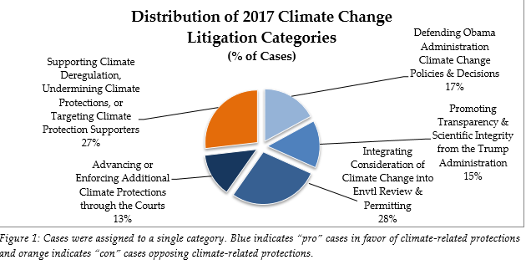
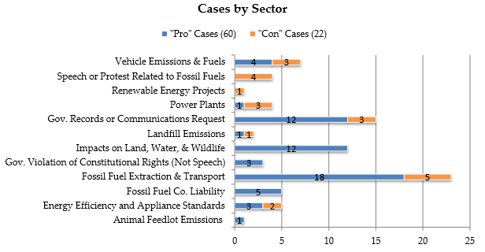
Climate Change Litigation -- Overview)
2017 Overview of Pending Climate Change Cases:

Slide 42
The Future of Climate Change Litigation
Climate change cases will likely continue to proliferate at home and abroad, especially to the extent additional supportive scientific data is disseminated and evidence of related damage is disclosed.
However, “Big Ten” U.S. based pending cases will play a significant role in future climate change litigation.
One of the most significant issues right now is whether the CAA preempts a state common law nuisance remedy:
NY Federal Court 7/19/18 Dismissal Ruling stated “it would … be illogical to allow the City to bring state law claims when courts have found that these matters are areas of federal concern that have been delegated to the executive branch, as they require a uniform, national solution.”

Slide 43
The Future
U.S. Supreme Court has shown its willingness to accept climate change cases for decision.
Possible creation of MDL to coordinate discovery in multiple climate change cases that survive motions to dismiss?
Possible attempt by Legislative branch to address the issue?
According to the London School of Economics, there are over 1,000 climate change lawsuits, with 800 having been brought in the U.S.

Slide 44
Climate Change - Damages
What are the damages and associated costs from climate change?
Two words: Far-reaching and seemingly unquantifiable
Impacts from sea level and temperature rise include but are certainly not limited to:
- Direct damage to real and personal property
Costs to mitigate against sea level rise (dams, levees, raising/strengthening buildings and structures, relocation, etc.)
loss of natural resources (e.g. complete submergence of sensitive wetlands, impacts to fish and wildlife)
Bodily injury
Increased waterborne pests & associated disease (mosquitos, etc.)
Damage to crops, soil erosion.
Salinization and other contamination of potable of water supply.
Loss of income
Loss of property value
Etc.… Etc. … The sky’s the limit (pun intended)
Will courts accept a volumetric allocation of fossil fuel companies’ contributions to GHGs to assign fault or perhaps a market share approach?

Slide 45
Damages
What are the damages and associated costs from climate change?
2017 Report from Zillow determined:
If sea levels rise as predicted by the year 2100, almost 300 U.S. cities would lose at least half their homes, and 36 U.S. cities would be completely lost.
One in eight Florida homes would be under water, accounting for nearly half of the lost housing value nationwide.
Nationwide, almost 1.9 million homes (or roughly 2 percent of all U.S. homes) – worth a combined $882 billion – are at risk of being underwater by 2100.

Slide 46
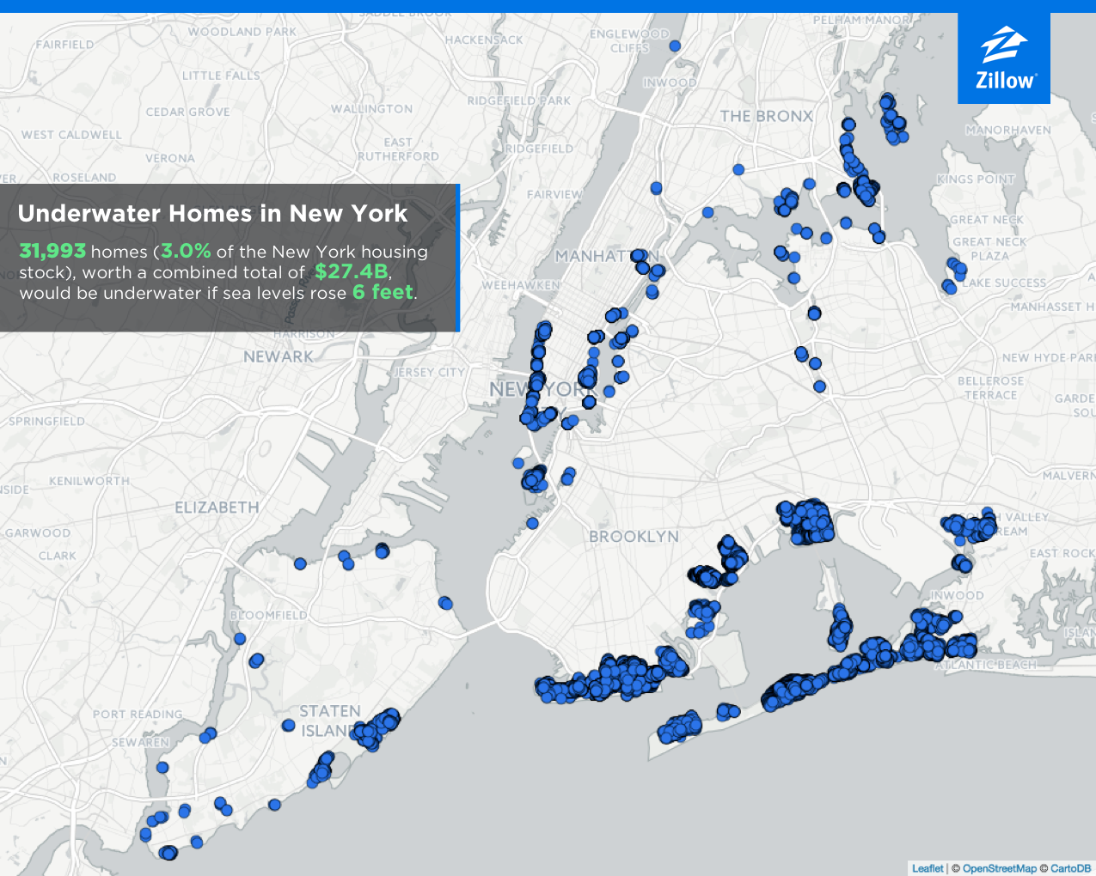
Damages
2017 Report from Zillow Reflecting Estimated Damage to N.Y. Homes From 6 Foot Sea Level Rise:

Slide 47
“Today’s flood will become tomorrow’s high tide.” (Margaret Davidson – Founder of NOAA’s Coastal Services Center) Questions?

Slide 48
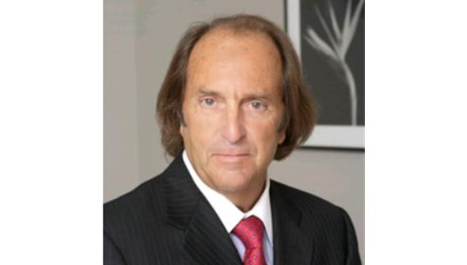
Richard K. Traub
+1 732-275-7842
rtraub@tlsslaw.com

Slide 49
Contact Us
Adam D. Krauss, Esq. | New York
Partner
(914) 347-2600
akrauss@tlsslaw.com
The content in this presentation is intended for informational purposes only. This information does not constitute legal advice. The law is constantly changing and the information may not be complete or correct depending on the date of the article and your particular legal problem. Each legal problem depends on its individual facts and different jurisdictions have different laws and regulations. Because of these differences, you should not act or rely on any information contained in this presentation without seeking the advice of a competent attorney licensed to practice law in your jurisdiction for your particular problem. Traub Lieberman Straus & Shrewsberry LLP makes no representation that content in this presentation is appropriate or available for use.

